Slide 1
The introduction of preliminary mapping between ISO 21378:2019 and SAF-T 2.0
Reporter：Dr. Lyu Tianyang
Date：2022.5.5

Slide 2

CONTENTS
1
The background of two standards
2
Comparison of two standards
3
Current work of ISO/TC 295
4
Our questions
5
Next Work Plan

Slide 3
The background of two standards
PART 1

Slide 4
Part1.1 The introduction of ISO/PC 295
To leverage the disperse efforts(AICPA, CHN Standards） in standardisation of data collected from auditees（especially enterprises). We applied for the establishment of the “audit data collection”Project Committee.
ISO/PC 295 was approved in 2015.
ISO/PC 295 is ISO's first Project Committee in the field of audit.
01
02
03
Independent from accounting and ERP systems, PC 295 aimed to bridge auditors with auditees, software developers and IT professionals.

Slide 5
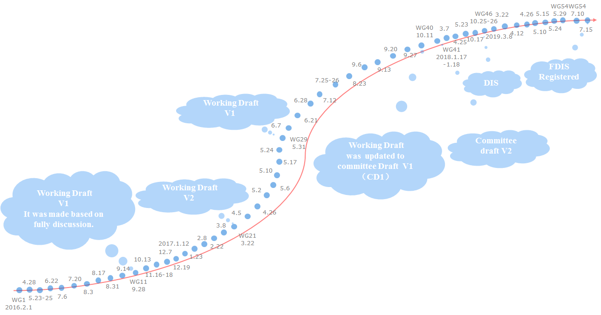
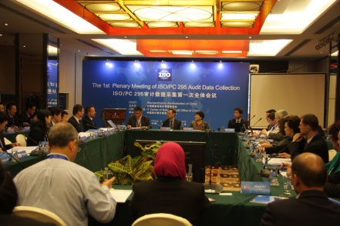
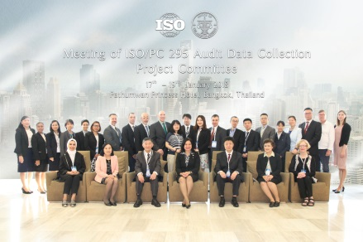
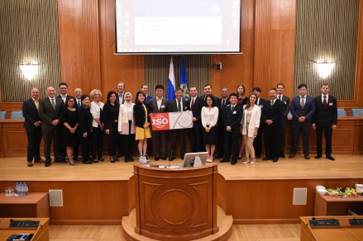
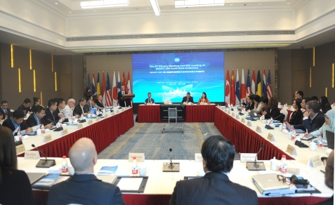
Part1.1 The development of ISO 21378:2019
The first PC meeting
Beijing
2015.11.3-4
The third PC meeting
Bangkok
2018.1.17-19
The second PC meeting
Moscow
2017.7.25-27
The fourth PC meeting
Hangzhou
2018.10.25-27
ISO 21378:2019 was published in November 2019

Slide 6
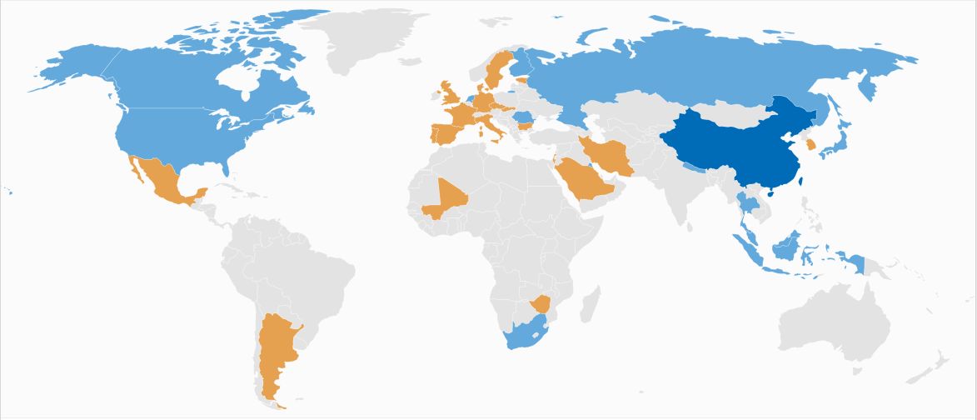














Part1.1 The participants of ISO/PC 295
Finland
Sweden
Estonia
Russian Federation
Canada
Denmark
Netherlands
United Kingdom
Slovakia
Japan
Germany
United States
France
Romania
Portugal
Bulgaria
Iran
South Korea
Spain
Czech Republic
Kuwait
Nepal
China
Italy
Mexico
Israel
Mali
Thailand
Saudi Arabia
Malaysia
Indonesia
Secretariat
Singapore
Participating members
Zimbabwe
Observing members
South Africa
Argentina
CNAO

Slide 7
Part1.1 The business and technical areas of ISO/TC 295
ISO/TC 295 covers the following business and technical areas:
Non-financial Enterprises
including ERP information and customs, tax payment, internal control information; the specifications on implementation in different file formats and for ERP vendors
Financial Reports
Tax
including balance sheets, income statements, statements of cash flows, statements of equity and related notes
including taxpayer’s basic and transaction information
Public Sector Budget
Social Insurance
including revenues (except tax) and expenditures
including pension and health insurance
collection
pre-processing
management
analysis

Slide 8
Part1.2 Globalization of OECD
02. Exchange of information
OECD has been at the forefront of international efforts to promote all forms of information exchange -including on request, spontaneous and automatic.
OECD establishment of a new single, common global standard on automatic exchange of financial account information in 2014 aimed at ending bank secrecy once and for all. ——CRS…..
01. Base erosion and profit shifting (BEPS)
Working together in the OECD/G20 Inclusive Framework on BEPS, 141 countries and jurisdictions are implementing 15 Actions to tackle tax avoidance, improve the coherence of international tax rules, ensure a more transparent tax environment and address the tax challenges arising from the digitalisation of the economy.
As of 4 November 2021, 137 countries and jurisdictions joined a new two-pillar plan to reform international taxation rules and ensure that multinational enterprises pay a fair share of tax wherever they operate.
03. Tax administration
The Forum on Tax Administration (FTA) was created in 2002 bringing together Commissioners and tax administration officials from 53 OECD and non-OECD countries, including all members of the G20. The vision is to enhance tax administration around the world.

Slide 9
Part1.2 The development of SAF-T
2010.4
The OECD published Guidance for the Standard Audit File-Tax version 2.0. It updates SAF-T version 1.0 issued in 2005 to include information on Inventory and Fixed Assets.
2005.5
The OECD′s Committee on Fiscal Affairs (CFA) approved two notes arising from work to develop a set of guidance on business accounting system data requirements for tax audit purposes.
The two notes are :
Guidance Note: Guidance on Tax Compliance for Business and Accounting Software
Guidance Note: Guidance for the Standard Audit File - Tax (SAF-T 1.0)

Slide 10
Comparison of two standards
PART 2

Slide 11

Part2.1 The scope of the two standards
ISO 21378:2019
Scope
SAF-T 2.0
Scope
This standard specifies common definitions of accounting data elements and provides the information necessary to extract relevant audit data.
This standard creates a mechanism for expressing the information, common
to accounting, in a manner independent of accounting and ERP systems.
It serves government audit, external independent audit, internal audit and other regulatory.
SAF-T is a file containing reliable accounting data exportable from an original accounting system, for a specific time period and easily readable by virtue of its standardisation of layout and format that can be used by external auditors and revenue body staff for compliance checking purposes. SAF-T advances efficient and effective audits by internal and external auditors and by revenue bodies.
SAF-T will assist auditors in testing electronic accounting data for the purposes of identifying risks and quantifying possible errors in the way tax rules have been applied.
Notes:
Source:①Guidance and Specifications for Tax Compliance of Business and Accounting Software
②Guidance for the Standard Audit File – Tax Version 2.0

Slide 12
Part2.1 Comparison of the scope
The same
Comparison
The difference
1
The data source
1
The objective of audit
Both are originated from Accounting/ERP System.
SAF-T 2.0 is focus on tax compliance.
The objective of ISO 21378:2019 is not only tax compliance but also other audit and assurance services.
2
Auditors
Both internal and external auditors are involved.
Notes:
税务机构：tax authority

Slide 13
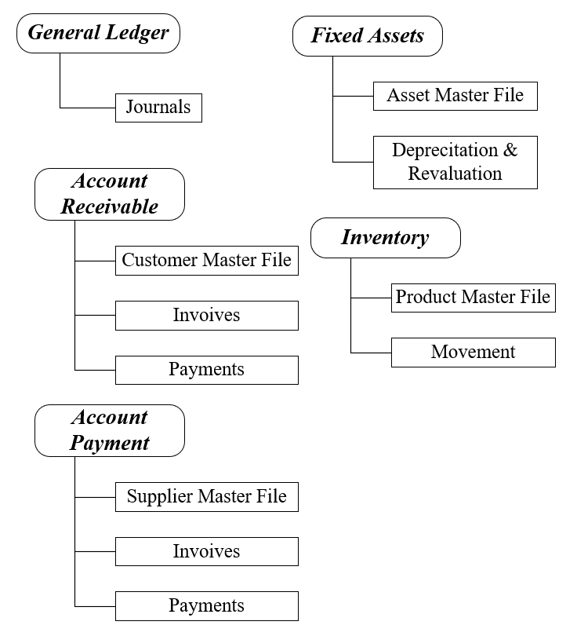

Part2.2 Comparison of the content
ISO 21378:2019
SAF-T 2.0
The difference
The output of ISO 21378:2019 covers the areas of General Ledger(GL), Accounts Receivable(AR), Sales, Accounts Payable(AP), Purchases, Inventory, and Property, Plant and Equipment(PPE).
SAF-T has been designed to capture data from a number of areas found in a typical business
accounting system as follows:
ISO 21378:2019 basically covers the modules involved in SAF-T 2.0

Slide 14
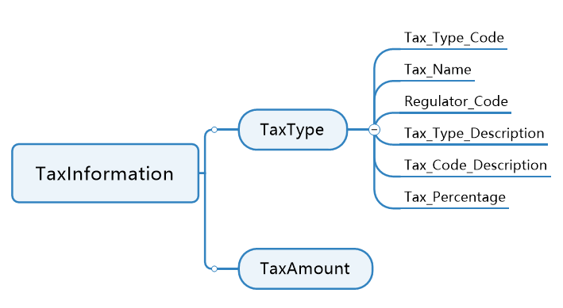
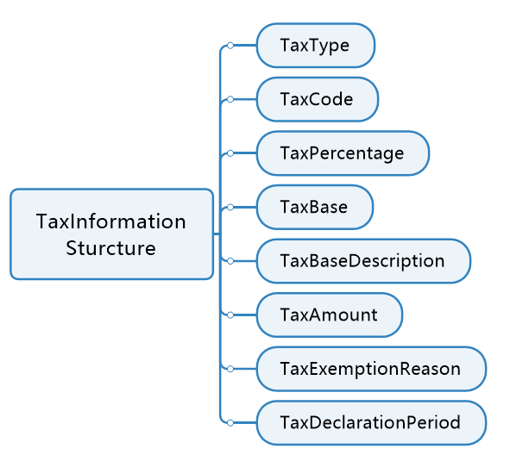
Part2.3 Comparison of the content detail
Detailed content comparison
The tax information
The representation of tax information
ISO 21378:2019
SAF-T 2.0
ISO 21378:2019
SAF-T 2.0
Raw data
Required processing
ISO 21378:2019 | Business Contexts | SAF-T 2.0
✘ | Product | ✔
✘ | General Ledger Entries | ✔
✔ | Sales Invoices | ✔
✔ | Purchase Invoices | ✔
✘ | Payment | ✔
✘ | Stock Movement | ✔
Simple
The relation between accounting treatment and tax treatment
Tax Type
Complex
Notes:
ERP对税务信息是按照交易去记录的，当涉及的税种简单时，可以通过会计账务反映税务的处理。但是，当涉及到所得税，复杂的税种时，是无法通过账务直接反映出税务的处理。

Slide 15
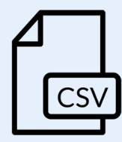






Part2.4 Comparison of technology
ISO 21378:2019
SAF-T 2.0
Output Format
Import
Data Element
Data Element
Database
Table
Csv
Audit System Database
XML Schema
Auditee A
Object
Data interface program embedded in auditee information system
system direct connection
Subclass
Subclass
……
Auditee B
….
….
Audit Data
Standards
Interface
Program
Data center of
auditing
Extracted from backup files
AuditFile
Manually
Typing
Output Format
Auditee C
Auditee D
No information system
Import

Slide 16
Current work of ISO/TC 295
PART 3

Slide 17
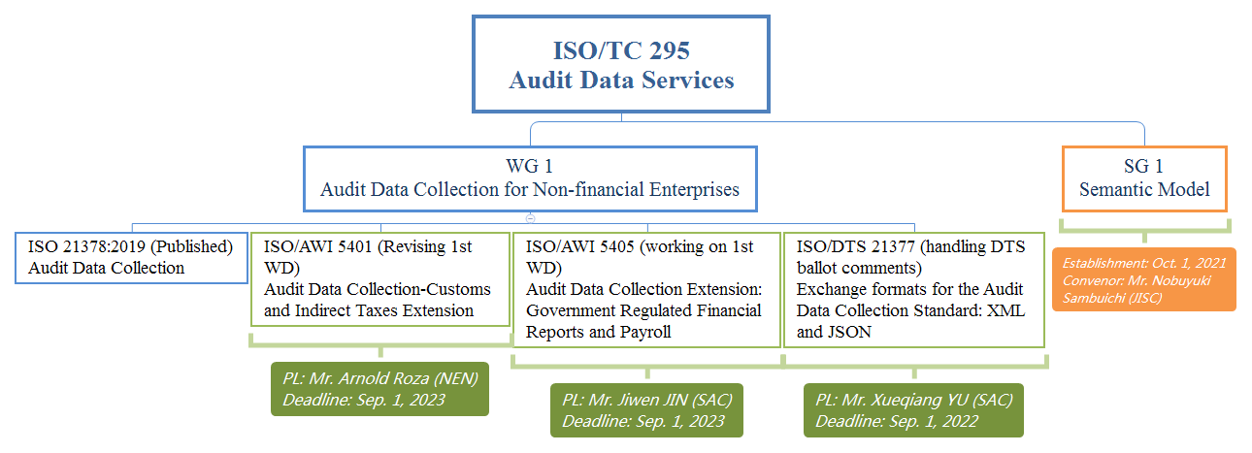
Part3.1 Structure of ISO/TC 295

Slide 18
Our questions
PART 4

Slide 19
Part4
A : Collect method
The revenue body collect from the corporate? or the corporate report to the revenue body? What data of the company collected by the revenue body (the scope of data)?
B : Application version
For one region/country, does the version of SAF-T 2.0 applied be the same?
C: Implementation
How is SAF-T 2.0 implemented?
Which ERP vendors could support SAF-T 2.0?
D: Other
Detailed problems at the object/element level

Slide 20
Next Work Plan
PART 5

Slide 21
Part5
2022.6-2022.8
（ Maybe four meetings）
2022.8-2022.11
（ Maybe six meetings）
2022.5-2022.6
（Maybe two meetings）
Data element level mapping and discussion of consensus
kick-off discussion of design principles/ general ideas
Table/Object level mapping and discussion

Slide 22
Thanks!

